Slide 1
REWARD PLATFORM

Slide 2
TEAM MEMBERS:
2010030436_K.DIMPLE
2010030438_K.SIRISHA
GUIDED BY:
Dr. P Lalitha Surya Kumari

Slide 3
PROBLEM STATEMENT:
Rewards Platform is a Blockchain-based solution for keeping track of customer reward points, creating a shared transaction ledger between all involved brands.

Slide 4
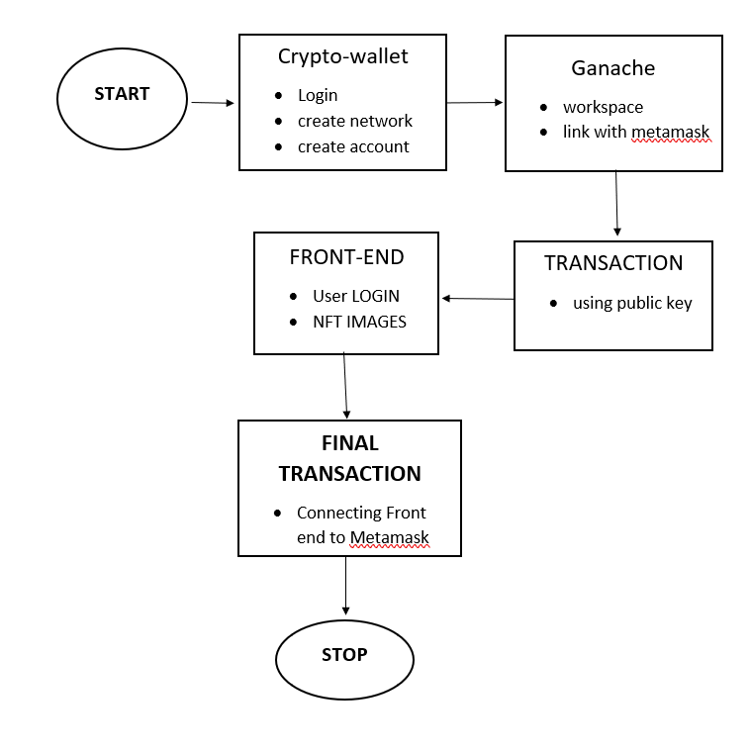
FLOW CHART:

Slide 5
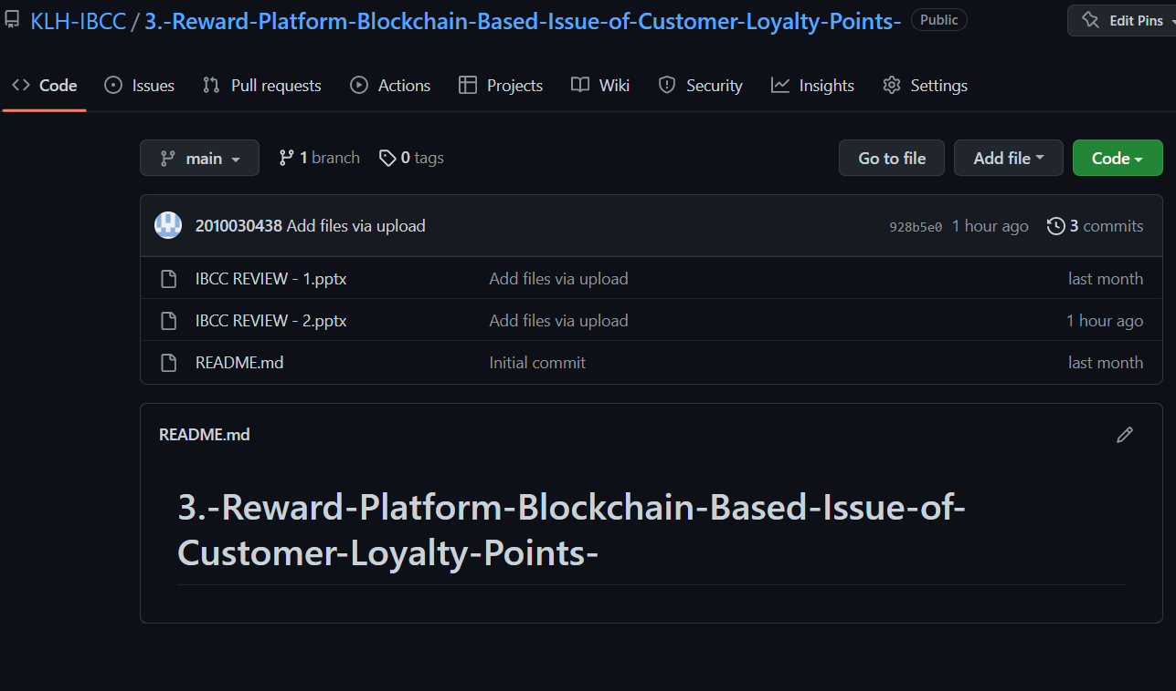
GITHUB COMMITS:
KLH-IBCC/3.-Reward-Platform-Blockchain-Based-Issue-of-Customer-Loyalty-Points- (github.com)

Slide 6
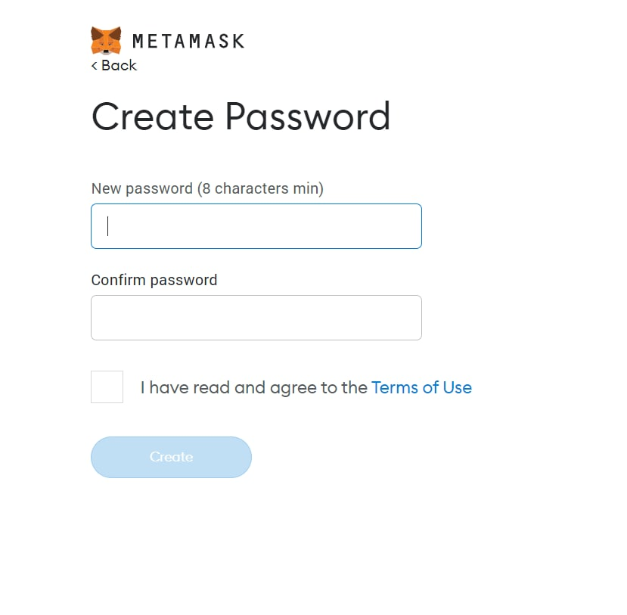
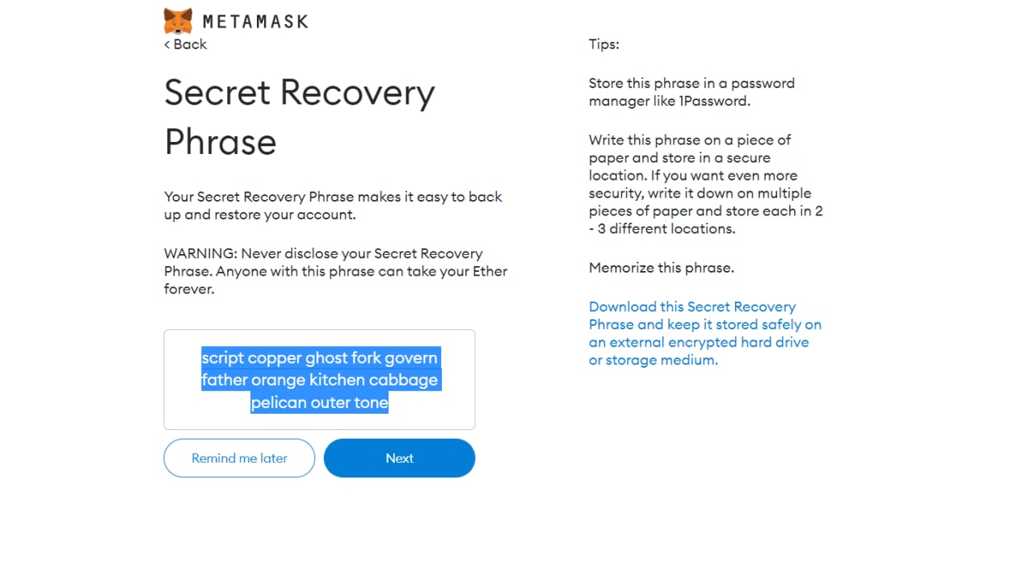
WORK PROGRESS :

Slide 7
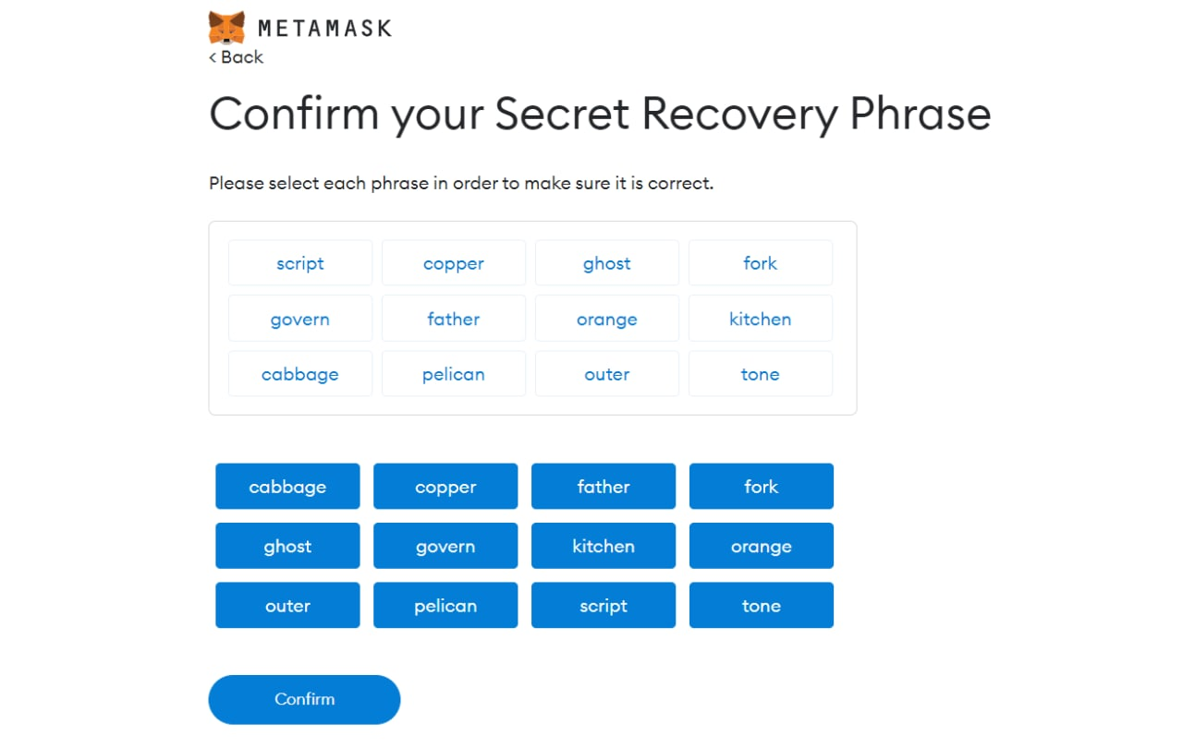
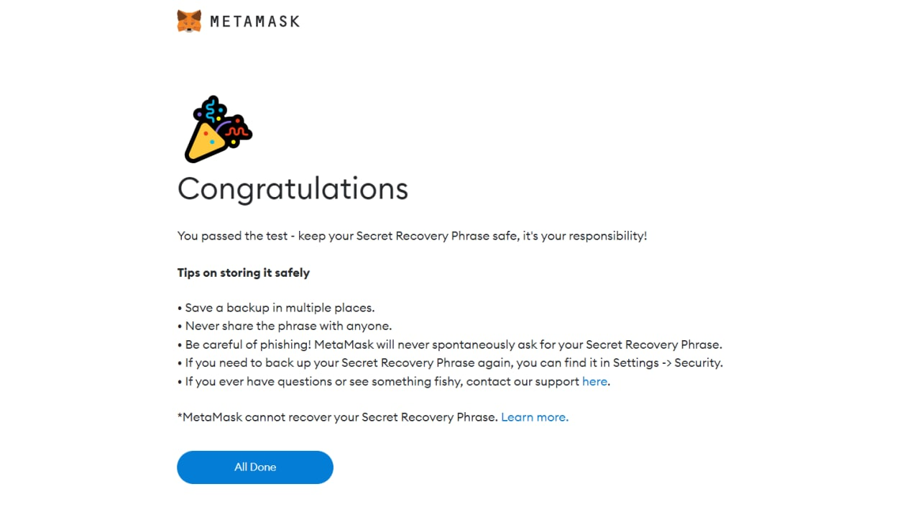

Slide 8
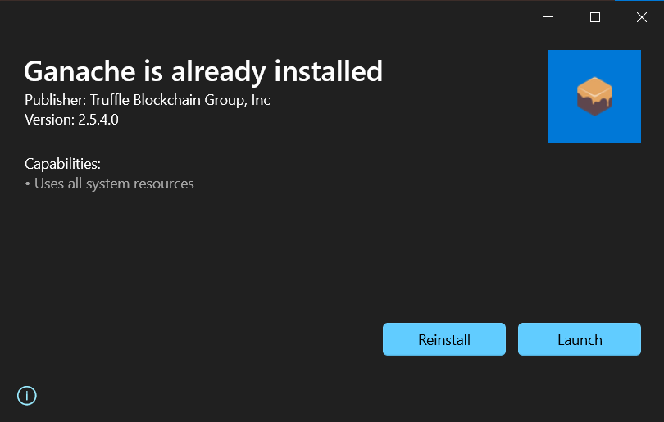
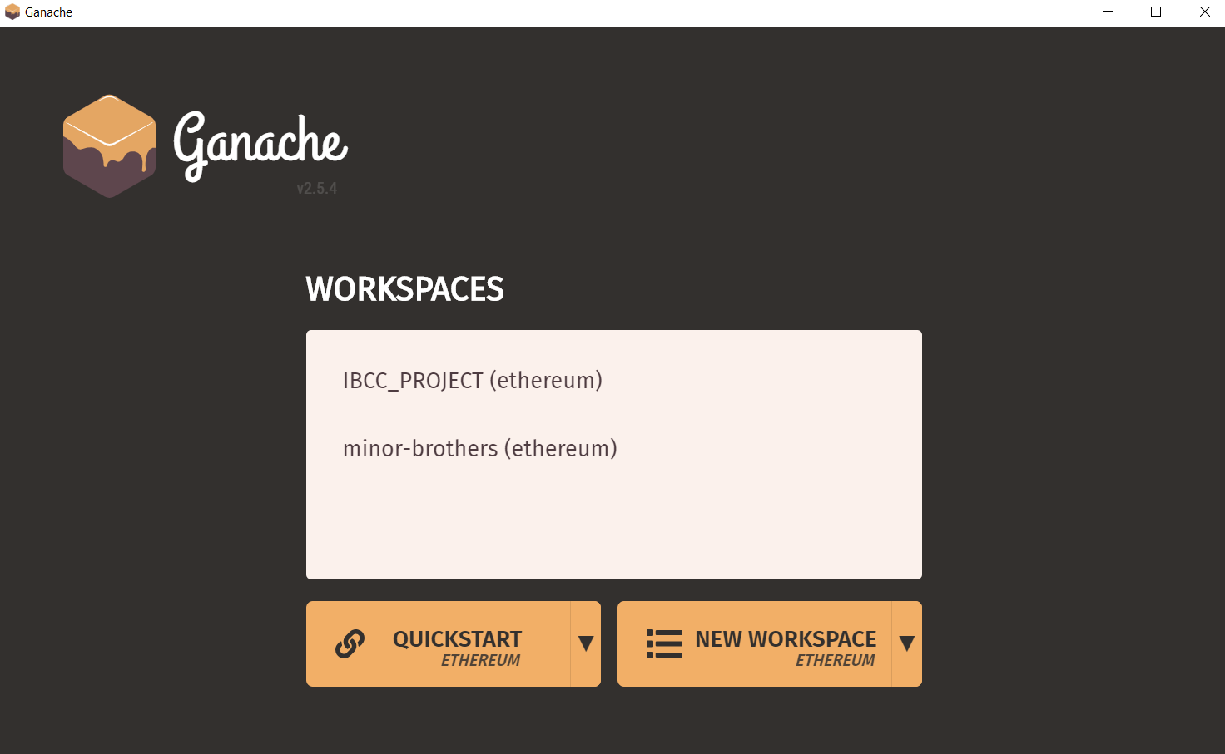
ALPHA TESTING :
CONNECTING GANACHE WITH MetaMask

Slide 9
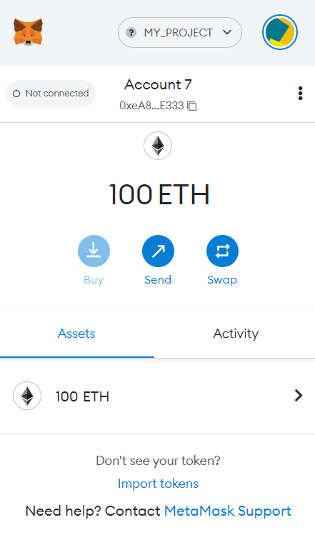
TRANSACTIONS:

Slide 10
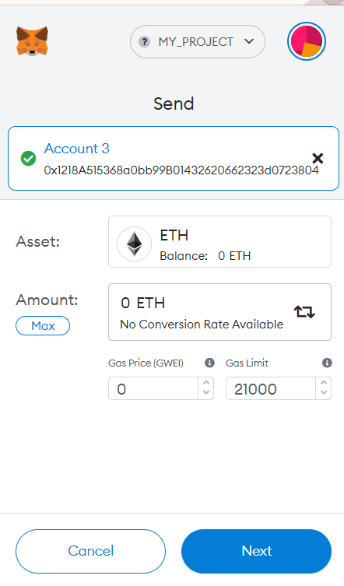
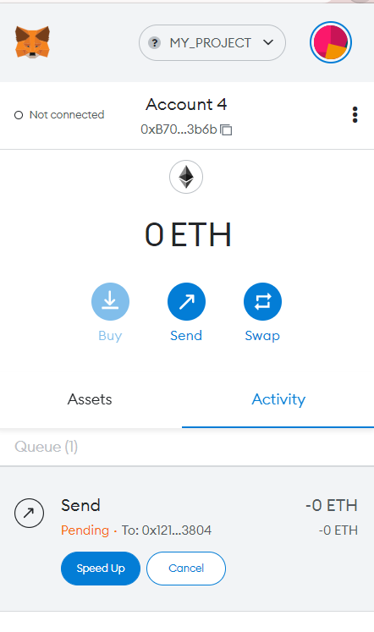

Slide 11
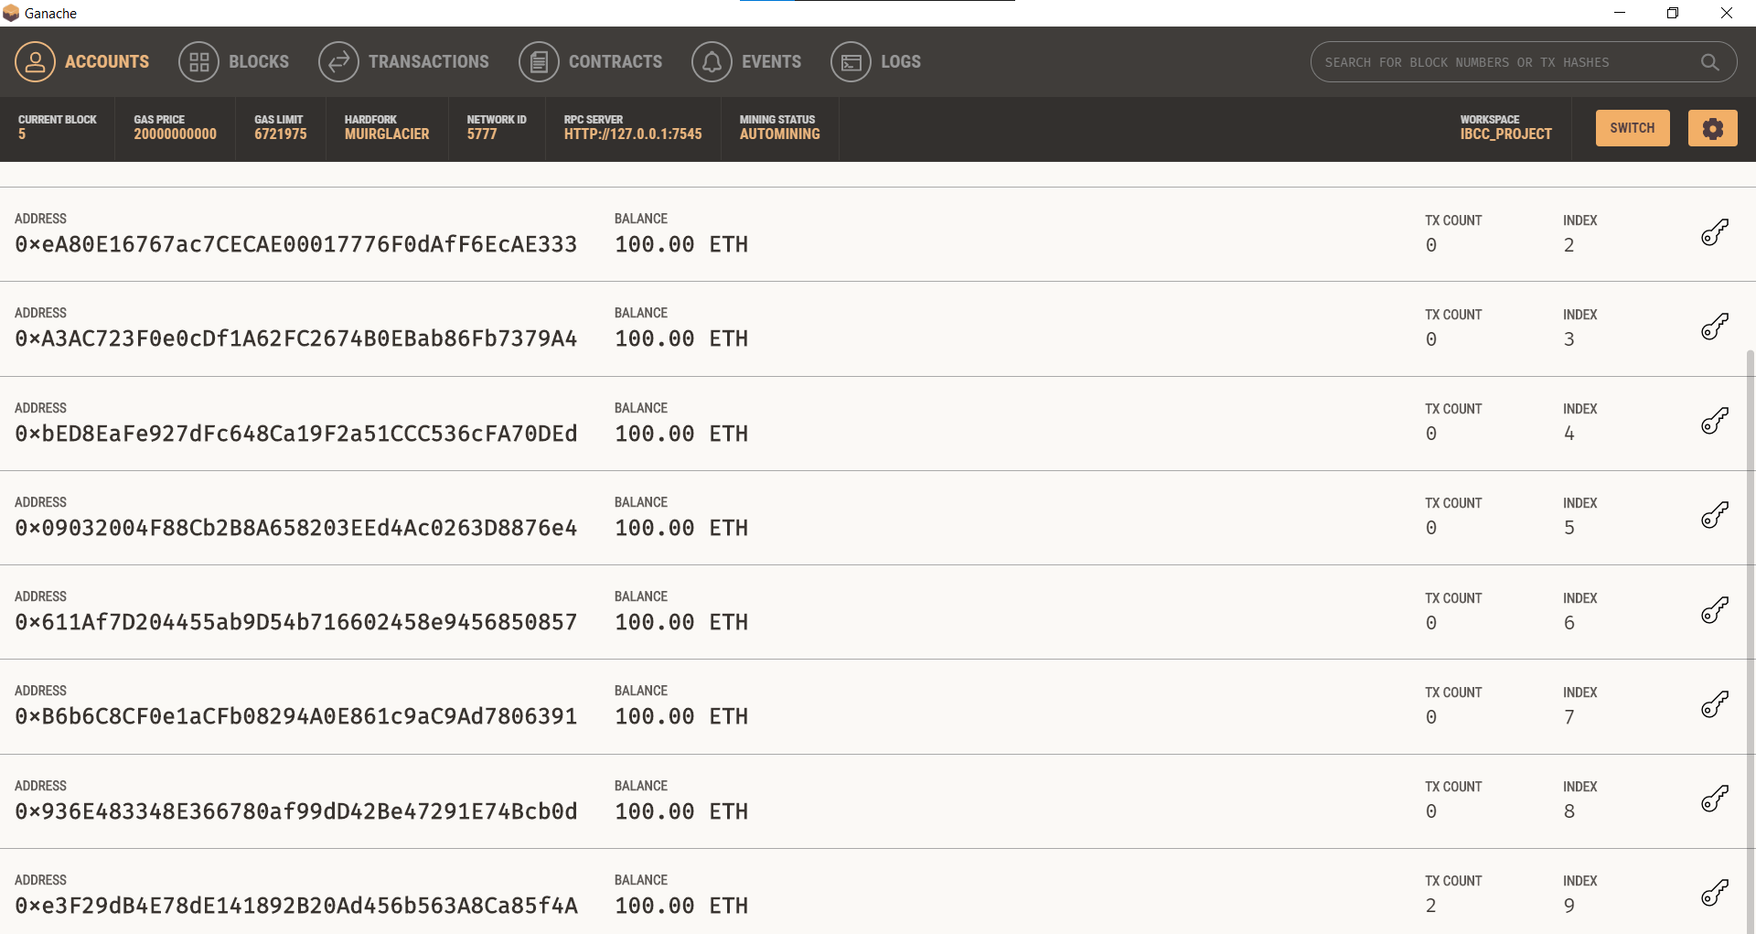

Slide 12
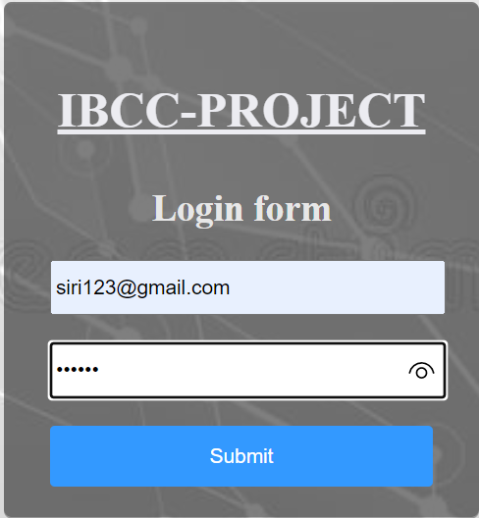
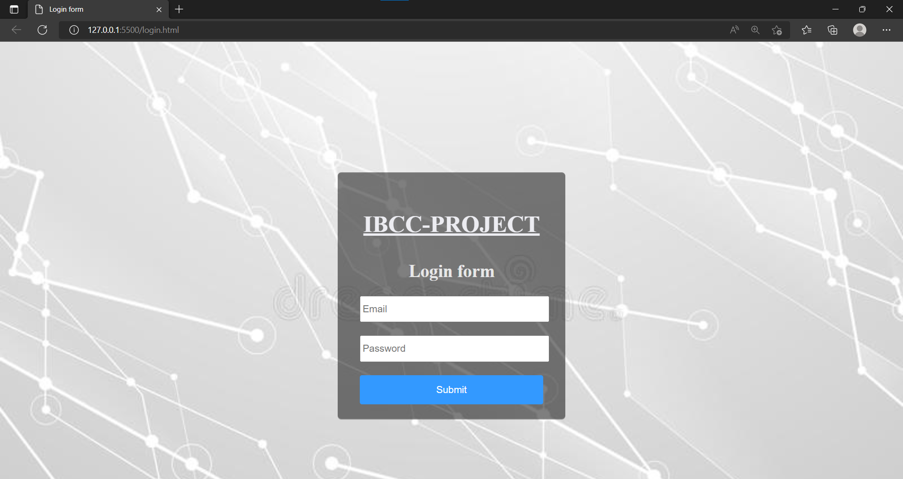
FRONT-END:

Slide 13
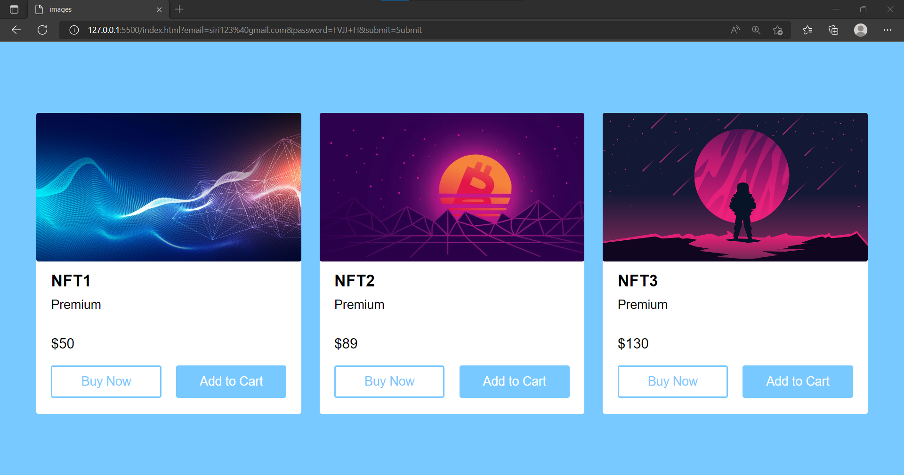

Slide 14
CONCLUSION:
Cryptocurrencies are changing fast, and they’re changing the financial scenario at the same speed. Blockchain technology is one of the best mechanisms for redeeming digital rewards in the form of crypto assets. The ability to issue a desirable reward is crucial for those companies that want to succeed in the new era of digital money.

Slide 15
THANK
YOU

